Slide 1
A Self-Rewarding Mechanism in Deep Reinforcement Learning for Trading Strategy Optimization
Milestone 5 Paper

Slide 2
Reinforcement Learning
Reinforcement learning is a type of machine learning where an agent learns by interacting with an environment.
It takes actions, gets rewards or penalties, and learns from experience to make better decisions over time.
For example: A self driving car, self cleaning vacuum cleaner etc.

Slide 3
Reward Function
Reward function is a fundamental concept of RL that guides an agent’s actions by giving feedback.
It is a mathematical function that assigns a numerical value (reward or penalty) to an agent’s action in a given state.
The goal of the RL agent is to maximize the total accumulated reward over time.
Example: Consider an agent trained to play a chess game.
Here the state is current board position.
Action: Move a Piece.
Here the reward function can be
+100 for checkmate
-50 for losing the game
+10 for capturing opponent piece.

Slide 4
Reward Function vs. Loss Function
Loss Function: Measures the difference between predicted and actual values in a model. It helps in training by adjusting model weights to improve accuracy.
Reward Function: Provides feedback to an agent by assigning a reward or penalty based on its action. The agent learns by trying to maximize the accumulated reward.
Key Difference: Models aims to reduce loss while RL agents maximize reward.

Slide 5
Challenges in Reinforcement Learning (Trading)
Traditional Reinforcement learning method typically rely on predefined static reward function. Although this approach can help the agent to achieve their goal to some extent.
Predefined reward functions often lack sufficient flexibility making it difficult to adapt to dynamic changes in the environment, thus by limiting the performance and adaptability of the algorithm.

Slide 6
Example: Reward Functions in Trading Strategy
Let's consider the trading platform. The design of reward function can vary significantly depending on the specific objectives and preferences of the investors involved in trading strategy.
For risk averse investors integrating risk measures into return function is crucial to ensure stability alongside profitability.
One of the commonly used matrix is the Sharpe Ratio which evaluates the risk adjusted return by comparing the expected return to the volatility of the portfolio. This allows a RL agent to optimize for not just higher return but also lower risk making the strategy more appealing to conservative investors

Slide 7
Example cont..
Some investors prioritize short term gains and may prefer reward functions that emphasis on immediate returns. So, reward function should be optimized for immediate returns rather than risk management.
There are some investors who adopt for multi-objective perspective, seeking to balance both short-term return and risk measures such as Sharpe Ratio. In such cases reward function is designed to incorporate multiple objectives, allowing RL agent to optimize for a combination of immediate and risk adjusted performance.

Slide 8
Evolution of Reward Function
As RL evolved researchers sought adaptive methods leading to the use of neural network to dynamically learn from data. It allows real time reward adjustments based on the state changed. Even though the reward function achieved adaptability it become computationally inexpensive due to continues updates and is unstable.
To overcome inefficiencies in neural network based dynamic reward researchers introduced Supervised Reinforcement Learning that uses expert labels to train reward function. But main disadvantage is that this approach requires high quality expert labelled data.
Most recent advancement like self rewarding language model and direct large language models introduces an innovative self rewarding deep reinforcement learning mechanism where the reinforcement leaning agent automatically refine their reward function using both expert knowledge and learned prediction.

Slide 9
Innovative Idea
Consequently, this paper also introduces a self rewarding mechanism with Double Deep Q Network named Self Rewarding Double Depp Q Network specially for financial trading.
SRDQN trading mechanism refines the learning process and drive the agent to make informed and profitable trading decision while optimizing the overall strategy performance.
The advanced time series feature extraction techniques such as TimesNet, WFTNet and Nlinear within the self rewarding framework significantly enhances the accuracy of the prediction.

Slide 10
Trading as a Markov Decision
The paper formalizes single asset trading as a Markov decision process within and RL framework.
Agent generates optimal trading strategy and execution by exploring a series of actions in a trading environment.
The state consists of the opening, high, low, closing process and trading volume from the past 20 days and 20 weeks at time t.
Actions are defined directly as sell, buy and hold.
The model combines Efficient Market Hypothesis with the Adaptive Market Hypothesis to reflect both the efficiency and it’s evolving nature.
EMH assumes that market fully reflect all information AMH adds that efficiency can change over time based on investor and market condition.

Slide 11
Innovation: Self-Rewarding Double Deep Q Network (SRDDQN)
Integrates self-rewarding mechanisms into an RL framework.
Inspiration – self rewarding language model.
Aiming to enhance the framework’s capabilities in the complex decision scenarios.
Process divided into two step:
Refining the learning process
Improving the efficiency of the trading strategy formulated by the RL method.

Slide 12
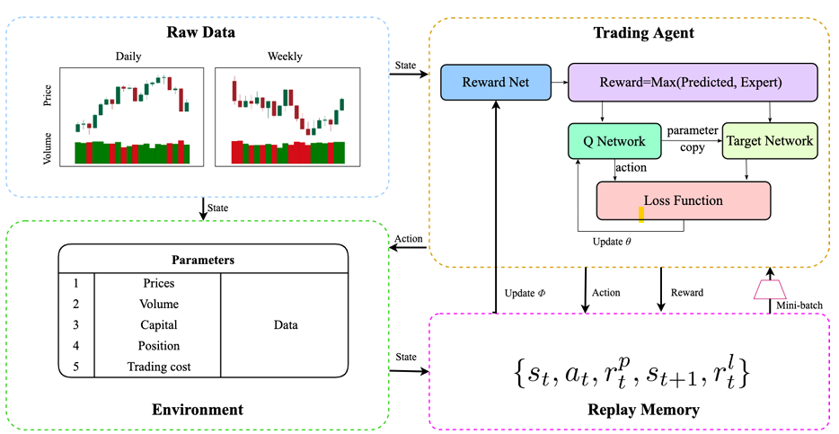
Structure of SRDDQN
SRDDQN has 4 core components:
Raw data processing
Environment
Trading Agent
Replay Memory.

Slide 13
Components Of SRDDQN
Raw Data Module - Process Input data such as daily and weekly OHLC. These features are fed into the environment.
Environment dynamically tracks the parameter like prices, trading volume, capital, position and trading cost. Environment generates state and reward information that drives the reinforcement learning process.
Trading agent consist of three networks : Reward Net, Q- Network and Target Network.
Reward Network predicts rewards based on advanced time series feature extraction models( TimesNet, WFTNet).
Q and Target network employ reinforcement learning algorithms to refine policy optimization through interactive adapt of network parameter.
The commuted actions and associated rewards are stored in the Replay Memory which is instrumental in experience replay and batch sampling during training.

Slide 14
Two-Phase Integration of Self-Rewarding Mechanism
First phase model employs supervised learning techniques to learn expert experience by approximating the self rewarding function using advanced time-series feature extraction networks.
This approach allows model to update the self-rewarding function parameter by comparing it’s own predicted rewards with the reward labels set by experts based on various matrix like Sharpe Ratio, Min-Max and Return.
In the second phase higher of reward function is selected which is then used as the reward of the RL framework. Advantage: More profitable and strategically sound trading decision.

Slide 15
Self-Rewarding Mechanism
Traditional RL reward function is manual and fixed which cab be limiting in dynamic environment such as financial market.
The paper introduces a self rewarding mechanism tailored for deep reinforcement leaning and aimed to enhance the performance of optimized single asset trading strategy.
A self rewarding mechanism allows the agent to adapt its reward function based on the environment and learning process.
RL agent can dynamically generate its own reward signals, instead of relying solely on predefined, static, reward functions provided by human experts.

Slide 16
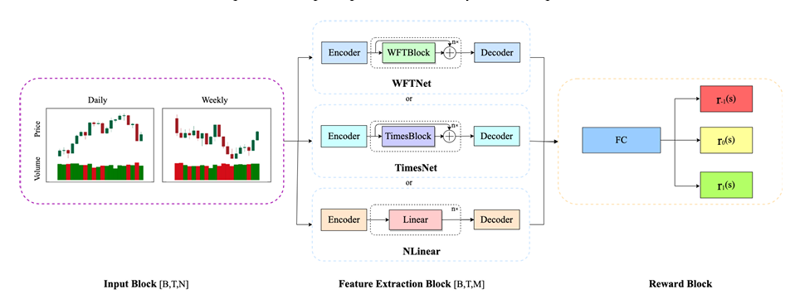
Representation of the Reward Net
Reward Net comprises three components Input, Feature Extraction and Reward Block.
The network uses supervised learning to acquire knowledge from experts by mimicking the self-rewarding function. It achieves this through the use of sophisticated time-series feature extraction models such as TimesNet, WFTNet, and NLinear
Moreover, the mechanism can select different reward functions designated by experts— such as Min-Max, Sharpe Ratio, and Return—as labels to guide the training of the reward network via supervised learning. By comparing the predicted rewards with the expert defined labels, the model selects the most favorable rewards.

Slide 17
Expert Defined Reward Matrix
These are hand-crafted reward functions used to guide a reinforcement learning agent's behavior based on domain knowledge. They ensure that the agent learns in a financially safe, interpretable, and goal-aligned manner.
Short-term Sharpe ratio reward: Based on the Sharpe Ratio, which evaluates how much return you’re getting per unit of risk. This variant measures the immediate effect of a trading action over a short future window (k days). Focuses not just on profit, but on stable profit.
Return-Based reward: Measures the immediate financial outcome of a trade. It is simple and intuitive. If you made money reward is positive, if you lost money, it is negative.
Min-Max Reward: The Min-Max reward function, tailored to reflect market dynamics over various durations, maximizes profit by considering the greatest benefits from different stock positions. Looks at the best and worst-case outcomes over a short time horizon (m days). The idea is to reward the agent for choosing positions that could maximize profit while minimizing downside risk.

Slide 18
SRDDQN
This paper presents a Self-Rewarding Double DQN (SRDDQN) model tailored for financial trading, which optimizes reward allocation by combining expert-defined labels with learned reward predictions to guide the agent’s decision-making.
The Double DQN framework addresses the overestimation bias inherent in DQN models, where Q-values may be inaccurately inflated, leading to suboptimal decisions.
Double DQN separates the action selection process from value estimation by maintaining two distinct neural networks: the main network (θ) and the target network (θ−).
The main network predicts Q-values for selecting actions, while the target network is used for value updates, reducing bias and stabilizing learning.

Slide 19
SRDDQN Cont..
For each action, a transition tuple (st,at,rt,st+1) is created, where st is the current state, at is the action taken, rt is the reward obtained, and st+1 is the next state. The reward rt is determined by comparing the predicted reward from the self-rewarding network (rs t) with the expert-defined reward (re t), selecting the higher of the two:
rt = max(rs t[at],re t[at])
The self-rewarding network estimates reward values for each action.
These predicted rewards are compared against expert-labeled rewards (expert knowledge), which are based on financial metrics like Min-Max, Sharpe Ratio, and Return.
The Q-value update is computed using the following equation: Q(st, at; θ) ← Q(st,at;θ) + αrt +γQ(st+1,amax(st+1;θ−)) − Q(st,at;θ) , where α is the learning rate, and γ is the discount factor. The term amax(st+1;θ) = argmaxat+1 Q(st+1,at+1;θ) represents the action that maximizes the Q-value in the next state st+1.

Slide 20
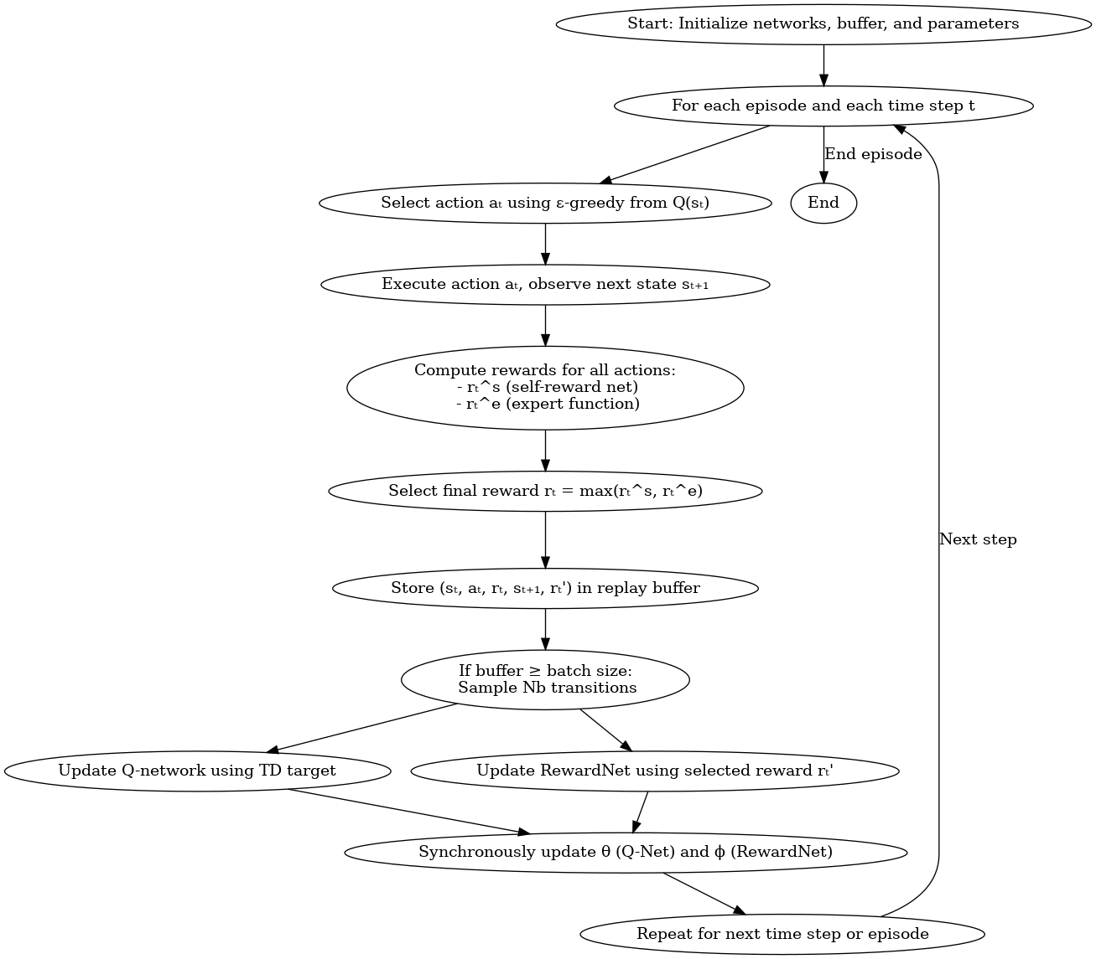
SRDQN Training
Training involves: • ε-greedy policy selects actions. • Agent observes state transitions. • Rewards from self-net and expert labels are compared. • The higher reward is used to train Q-Network and RewardNet. • Experience replay buffers provide sampled batches for learning. • Parameters are updated synchronously during training.

Slide 21
Experiment Results and Markets Tested
Validated on six major stock indices:
• 🇺🇸 DJI (USA)
• 🇺🇸 S&P 500 (USA)
• 🇺🇸 NASDAQ IXIC (USA)
• 🇫🇷 CAC40 FCHI (France)
• 🇰🇷 KOSPI KS11 (Korea)
• 🇭🇰 Hang Seng HSI (Hong Kong)
It proved adaptable to different market conditions, economic zones, and geopolitical environments—enhancing reliability and global scalability.

Slide 22
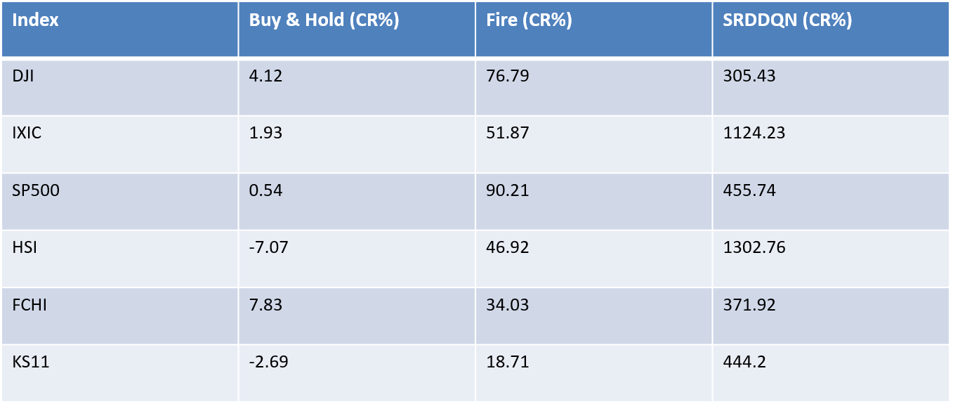
SRDDQN Comparison Across Global Markets - CR
Buy and Hold – Traditional Trading Strategy
Fire – DRL model
CR – Cumulative Return

Slide 23
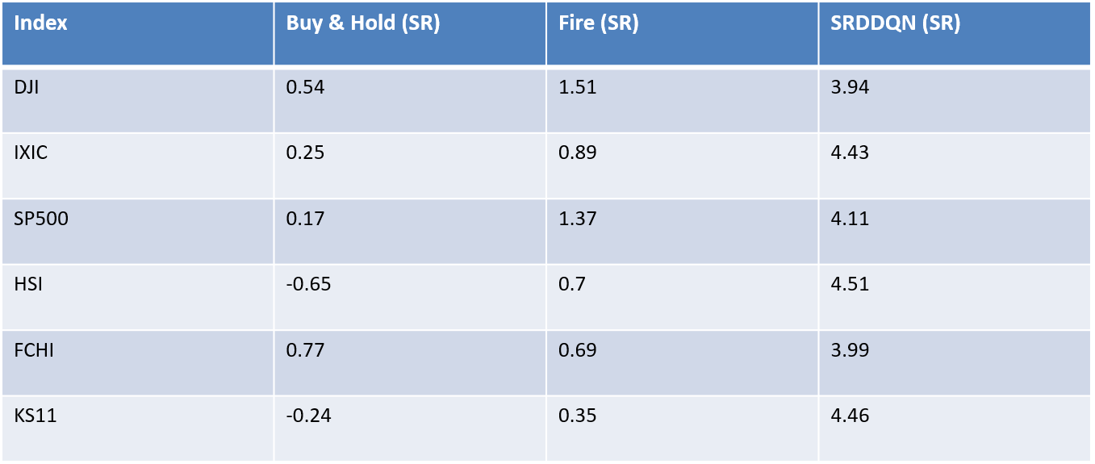
SRDDQN Comparison Across Global Markets - SR
Buy and Hold – Traditional Trading Strategy
Fire – DRL model
SR – Sharpe Ratio

Slide 24
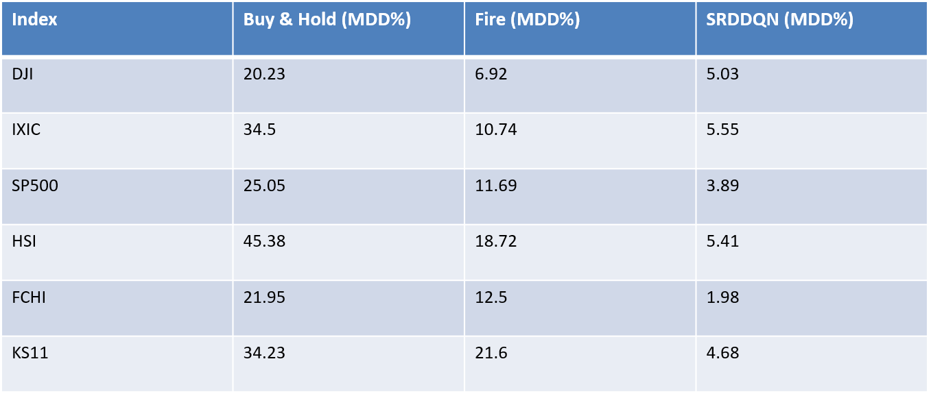
SRDDQN Comparison Across Global Markets - MDD
Buy and Hold – Traditional Trading Strategy
Fire – DRL model
SR – Maximum Draw Down

Slide 25
Conclusion & Key Takeaways
This paper presents a novel Self-Rewarding Deep Reinforcement Learning (SRDRL) framework that revolutionizes reward design in financial reinforcement learning by integrating expert-defined metrics (like Min-Max, Sharpe Ratio, and Returns) into a dynamic self-rewarding mechanism.
The proposed SRDDQN model, enhanced with advanced time-series extractors (e.g., TimesNet, WFTNet), shows significant improvements in trading performance, achieving over 436% cumulative return on DJI, outperforming all baseline models.
The method proves highly scalable, adaptable, and responsive to market conditions. Future work will explore multi-agent systems and LLMs (like GPT, FinBERT) to further enhance market understanding via sentiment analysis and NLP techniques.

Slide 26
Appendix:
🕯️ Candlestick Chart – Quick Explanation:
Each candle shows price action for a specific time interval (daily, weekly, etc.)
A single candlestick includes:
Open Price 📍 – Where the price started
Close Price 📍 – Where the price ended
High Price 📈 – The highest point reached
Low Price 📉 – The lowest point reached
Colors:
Green (Bullish) = Close > Open
Red (Bearish) = Close < Open
Paired with:
Volume Bars underneath — show how much was traded

Slide 27
Appendix: cont…
Volume: Number of shares/contracts traded during a time period. It act as a liquidity indicator that helps the agent avoid low-volume traps.
Capital: The total money the agent has left.
Position: Current holdings of the agent in each asset.
Types:
0: No position (flat)
1: Long position (buying asset)
-1: Short position (selling borrowed asset)

Slide 28
Appendix: cont…
Volume: Number of shares/contracts traded during a time period. It act as a liquidity indicator that helps the agent avoid low-volume traps.
Capital: The total money the agent has left.
Position: Current holdings of the agent in each asset.
Types:
0: No position (flat)
1: Long position (buying asset)
-1: Short position (selling borrowed asset)

Slide 29
Appendix: cont…
Experimental Setup and Setup
4.1 Dataset
Indices Used:
Hang Seng Index (HSI) – Hong Kong
CAC40 (FCHI) – France
KOSPI (KS11) – Korea
NASDAQ Composite (IXIC), S&P 500 (SP500), and Dow Jones (DJI) – USA
Purpose: To expose the model to diverse global market conditions, enhancing generalization and reducing overfitting.
Date Range:
Training Set: 1 Jan 2007 – 31 Dec 2020
Test Set: 1 Jan 2021 – 31 Dec 2023
Features Used:
Opening Price
Lowest Price
Highest Price
Closing Price
Trading Volume
Visual: Close Price Curves for all six indices (Figure 3)

Slide 30
Appendix: cont…
Evaluation Metrics
Cumulative Return (CR): Measures total return across the investment period.
Annualized Return (AR): Converts total return to a yearly average rate.
Sharpe Ratio (SR): Evaluates risk-adjusted return (excess return per unit of volatility).
Maximum Drawdown (MDD): Reflects the worst-case loss from a peak to a trough during the investment period.
These metrics give a balanced view of both performance and risk.

Slide 31
Appendix: cont…
Baseline Methods
✅ Traditional Strategies
Buy & Hold (B&H): Buy once, hold till the end.
Sell & Hold (S&H): Short sell at the beginning and hold the position.
Mean Reversion (MR): Uses 10-day Simple Moving Average (SMA); assumes prices revert to mean.
Trend Following (TF): Uses 10 & 20-day SMA crossover for buy/sell signals.
🤖 Deep Reinforcement Learning Models
TDQN: 5-layer DQN by Théate & Ernst for trading position optimization.
DQN-Vanilla: 2-layer DQN from Taghian et al., using OHLC data.
Fire (DQN-HER): Multi-objective DQN with dynamic reward/discounting from Cornalba et al., for stocks & crypto.

Slide 32
Appendix: Cont…
4.4 Experimental Setup
Training: Conducted individually on each stock index dataset.
Initial Capital: $500,000
Transaction Cost: 0.3% per trade
Frameworks:
Python v3.10
PyTorch v1.12
CUDA v12.1
Windows 10
GPU: NVIDIA RTX 4090
CPU: Intel Core i7-13700KF

